Slide 1
Coffee Vending Machines in School
MERCADO Rainer Maalik• DURANTE Lorenz

Slide 2
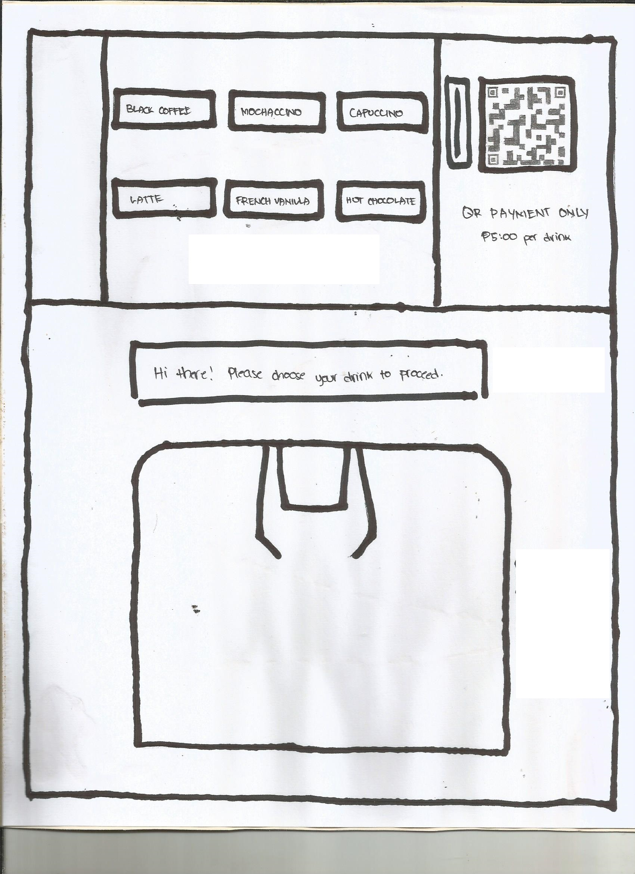

Slide 3
2nd Iteration
New and Improved Coin Slot

Slide 4
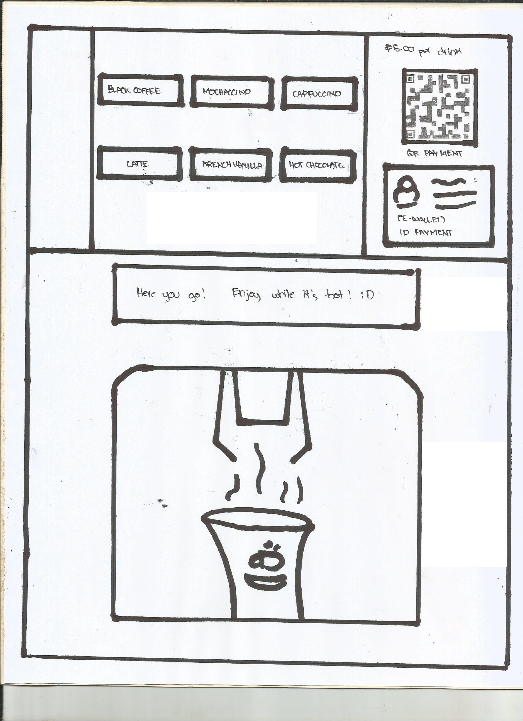
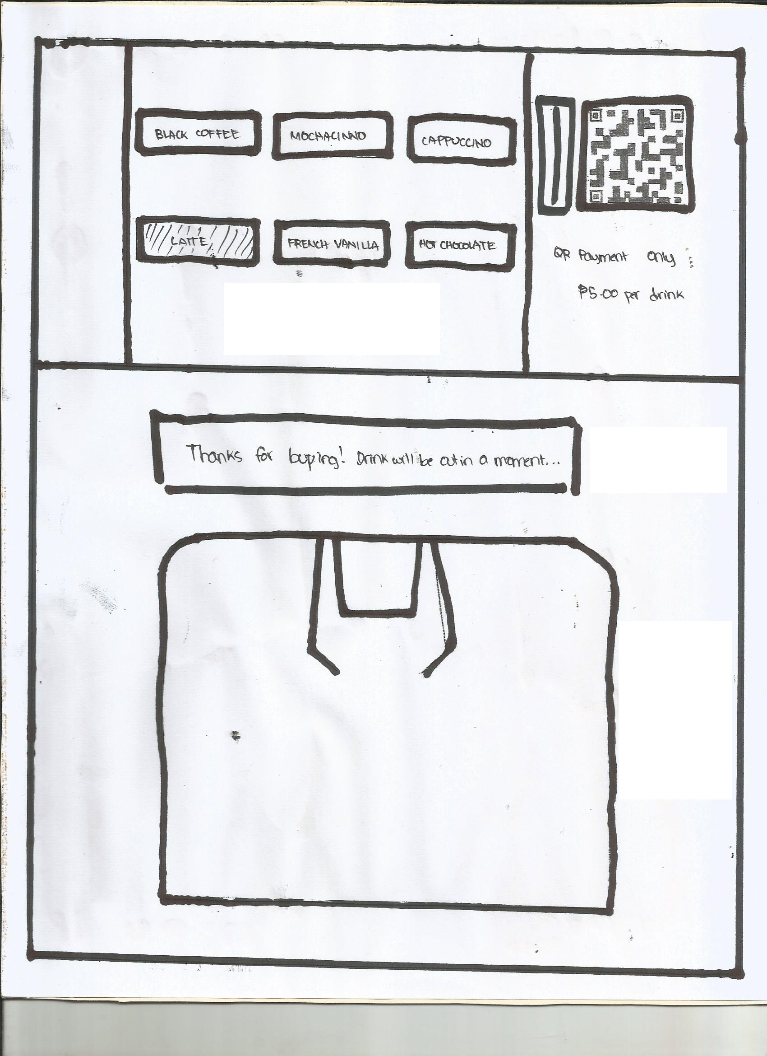

Slide 6
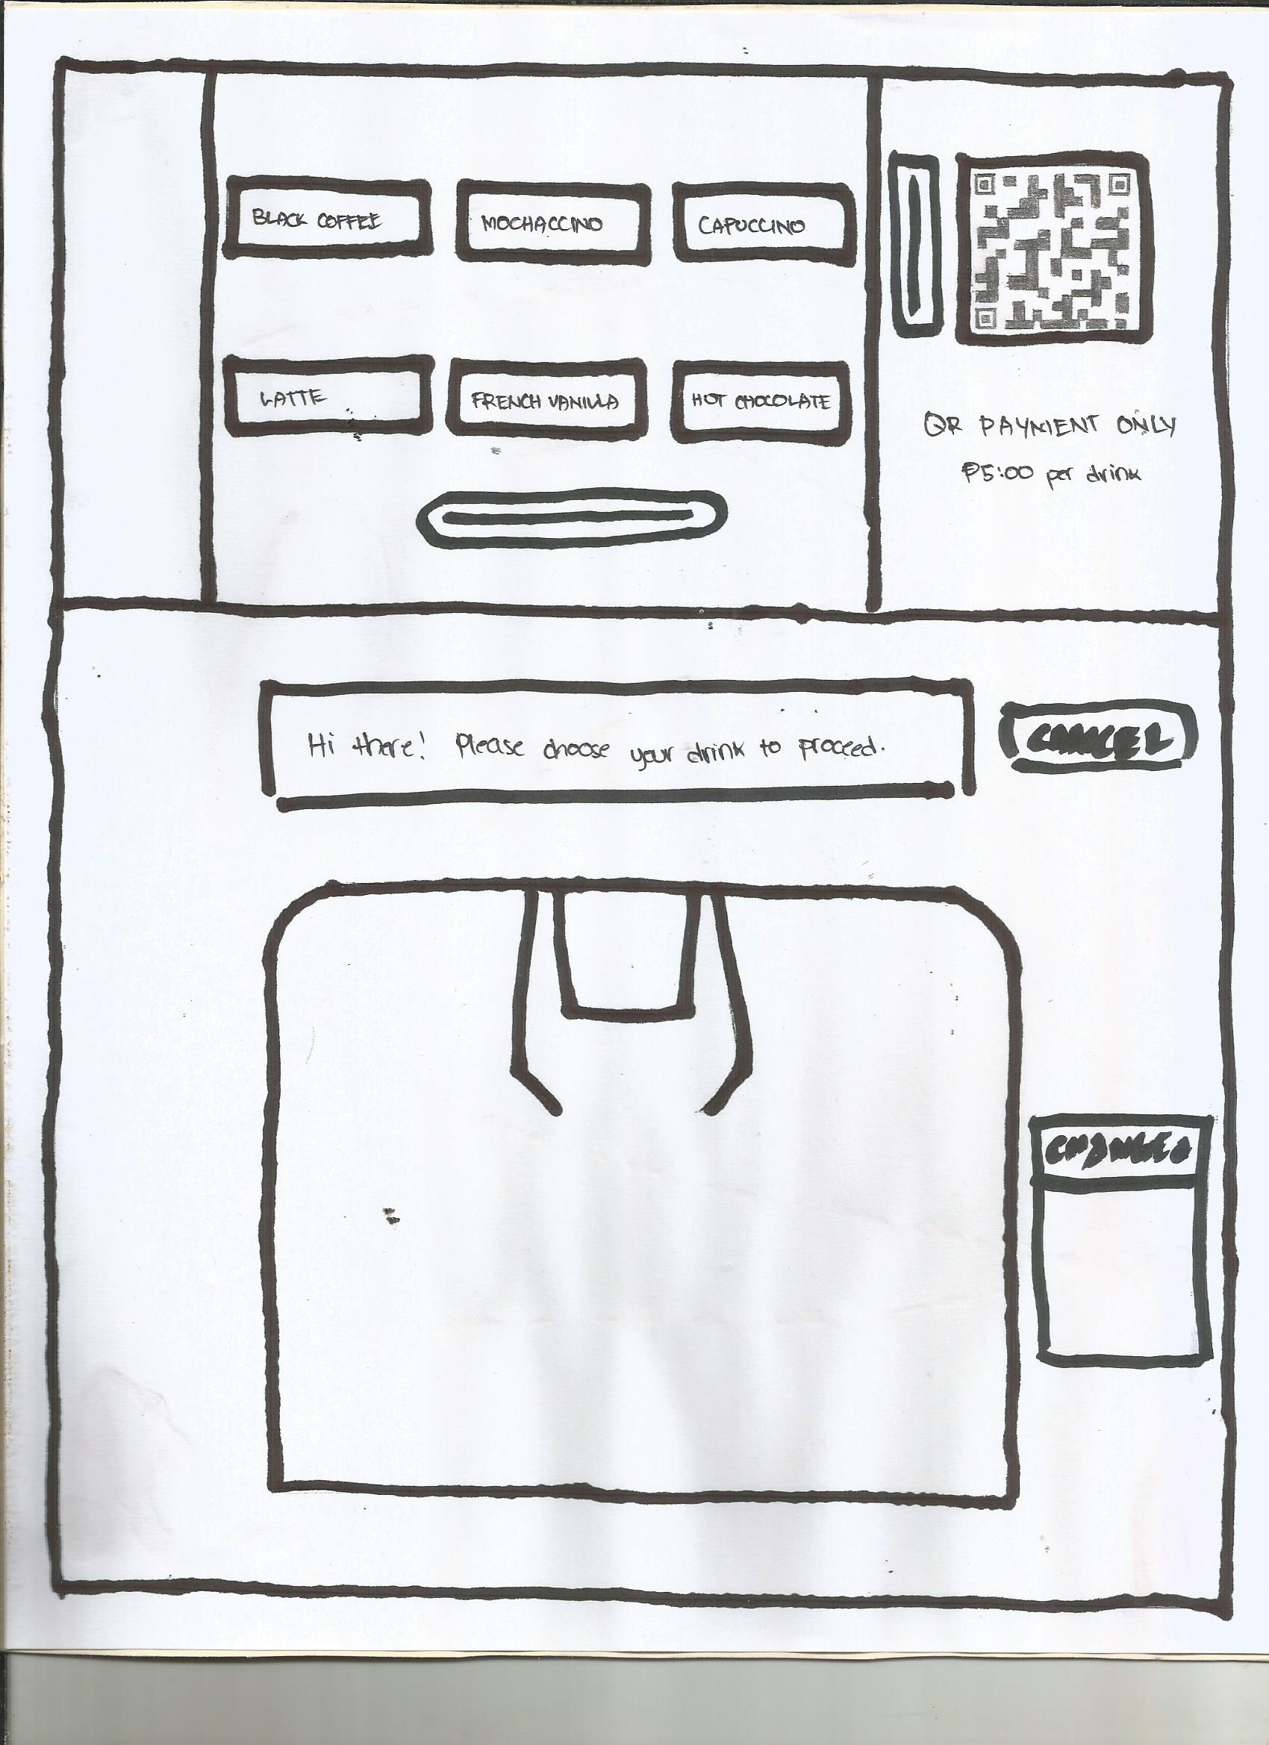
3rd Iteration
Coin & Bill Slot w/other more features

Slide 7
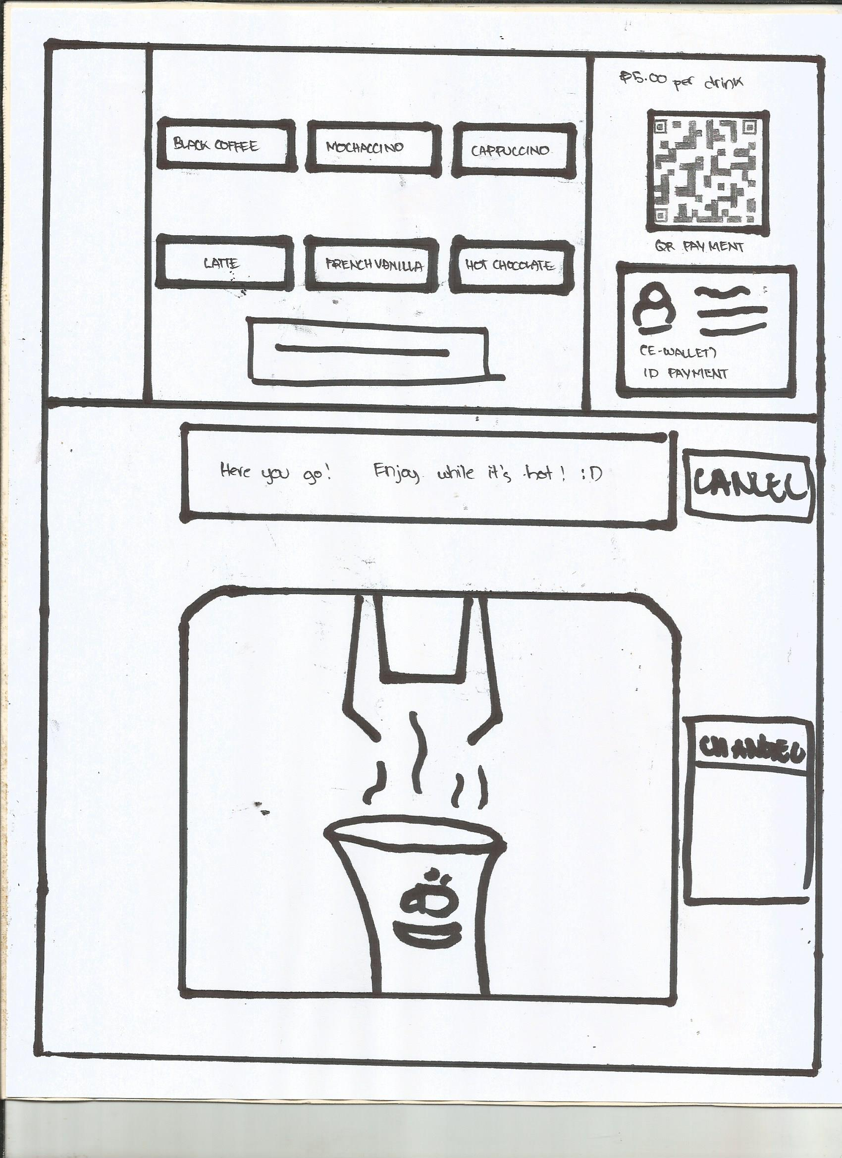
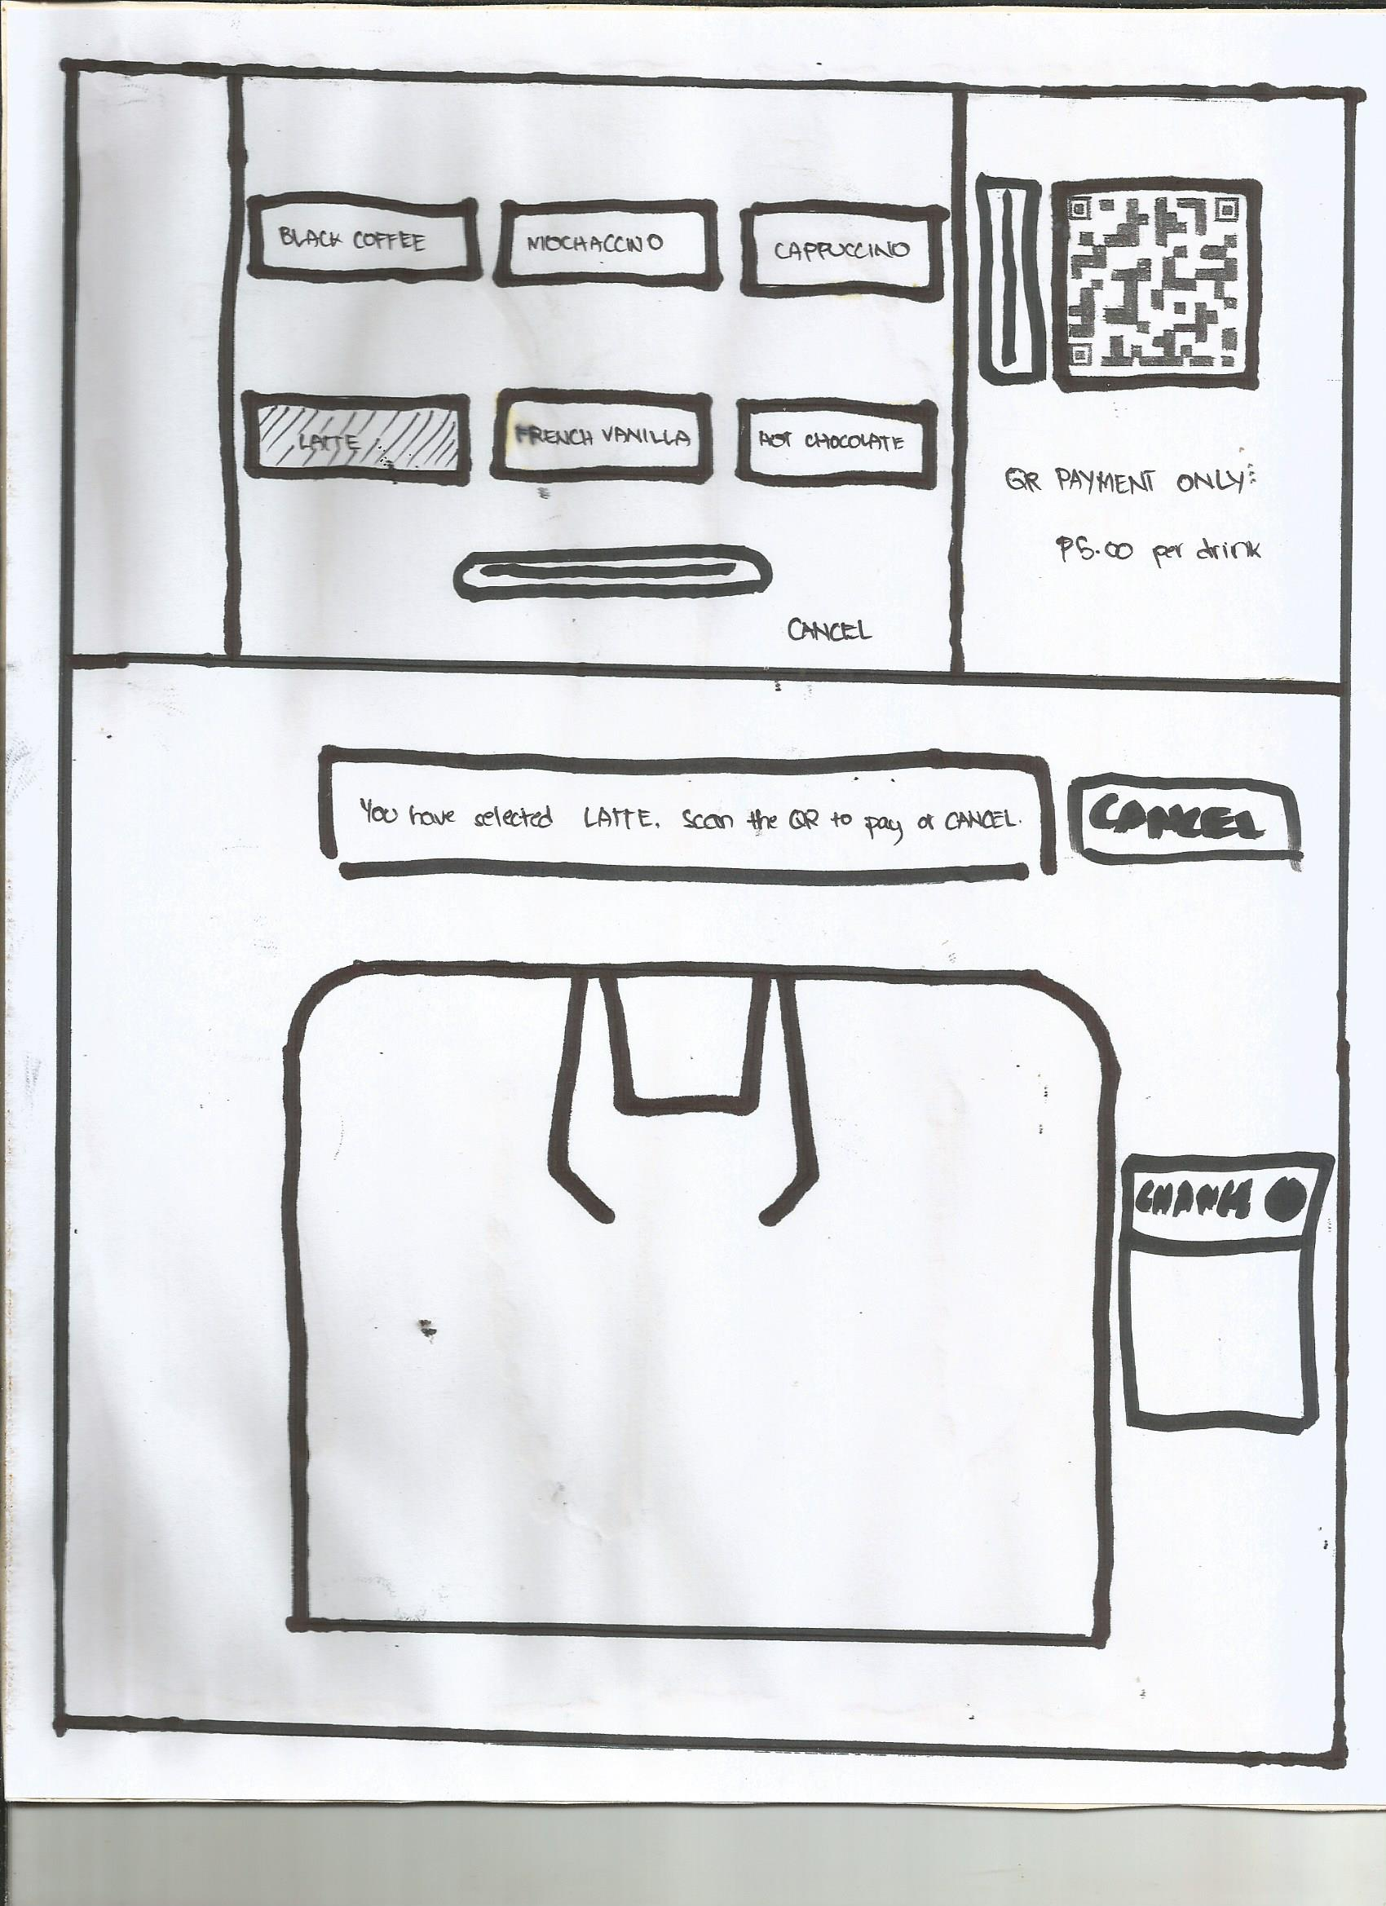
OBSERVATION
Lack of Accessible Coffee Vending Machines

Slide 8
Identified Needs
The APC Community, most especially students, now need to have a better way to access caffeinated drinks.
Students need a quick way for payment process.
Students need a wider variety of options for drinks.
Students need better features for the current one can improve on efficiency.
Students need an alternative way for payment process.

Slide 9
Points of View
FEW OPTIONS
Students, and the APC Community as a whole, need more choices of drinks instead of having just coffee for the offered drinks.
Not all people of the APC Community would drink coffee or caffeinated drinks, some would just need a warm drink which can be non-caffeinated.

Slide 10
Points of View
LIMITED USE OF FEATURES
The process of payment is very old-school. There’s a need for modernization and better efficiency.
The process of getting a drink is quite stale and now there is a need for using modern features.

Slide 11
Points of View
LACK OF ACCESSIBLE COFFEE VENDING MACHINES
Students need to have a better way of accessing a coffee machine, for a coffee machine is only located at certain floors inside the school.
Coffee vending machines should be dispersed around different floors for better convenience.

Slide 12
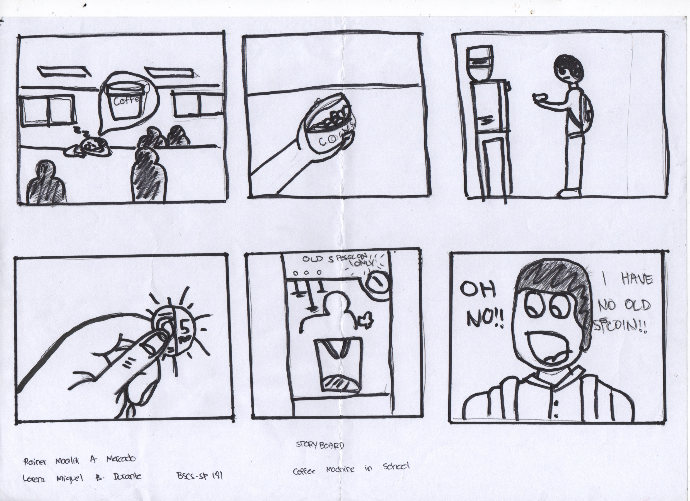

Slide 13
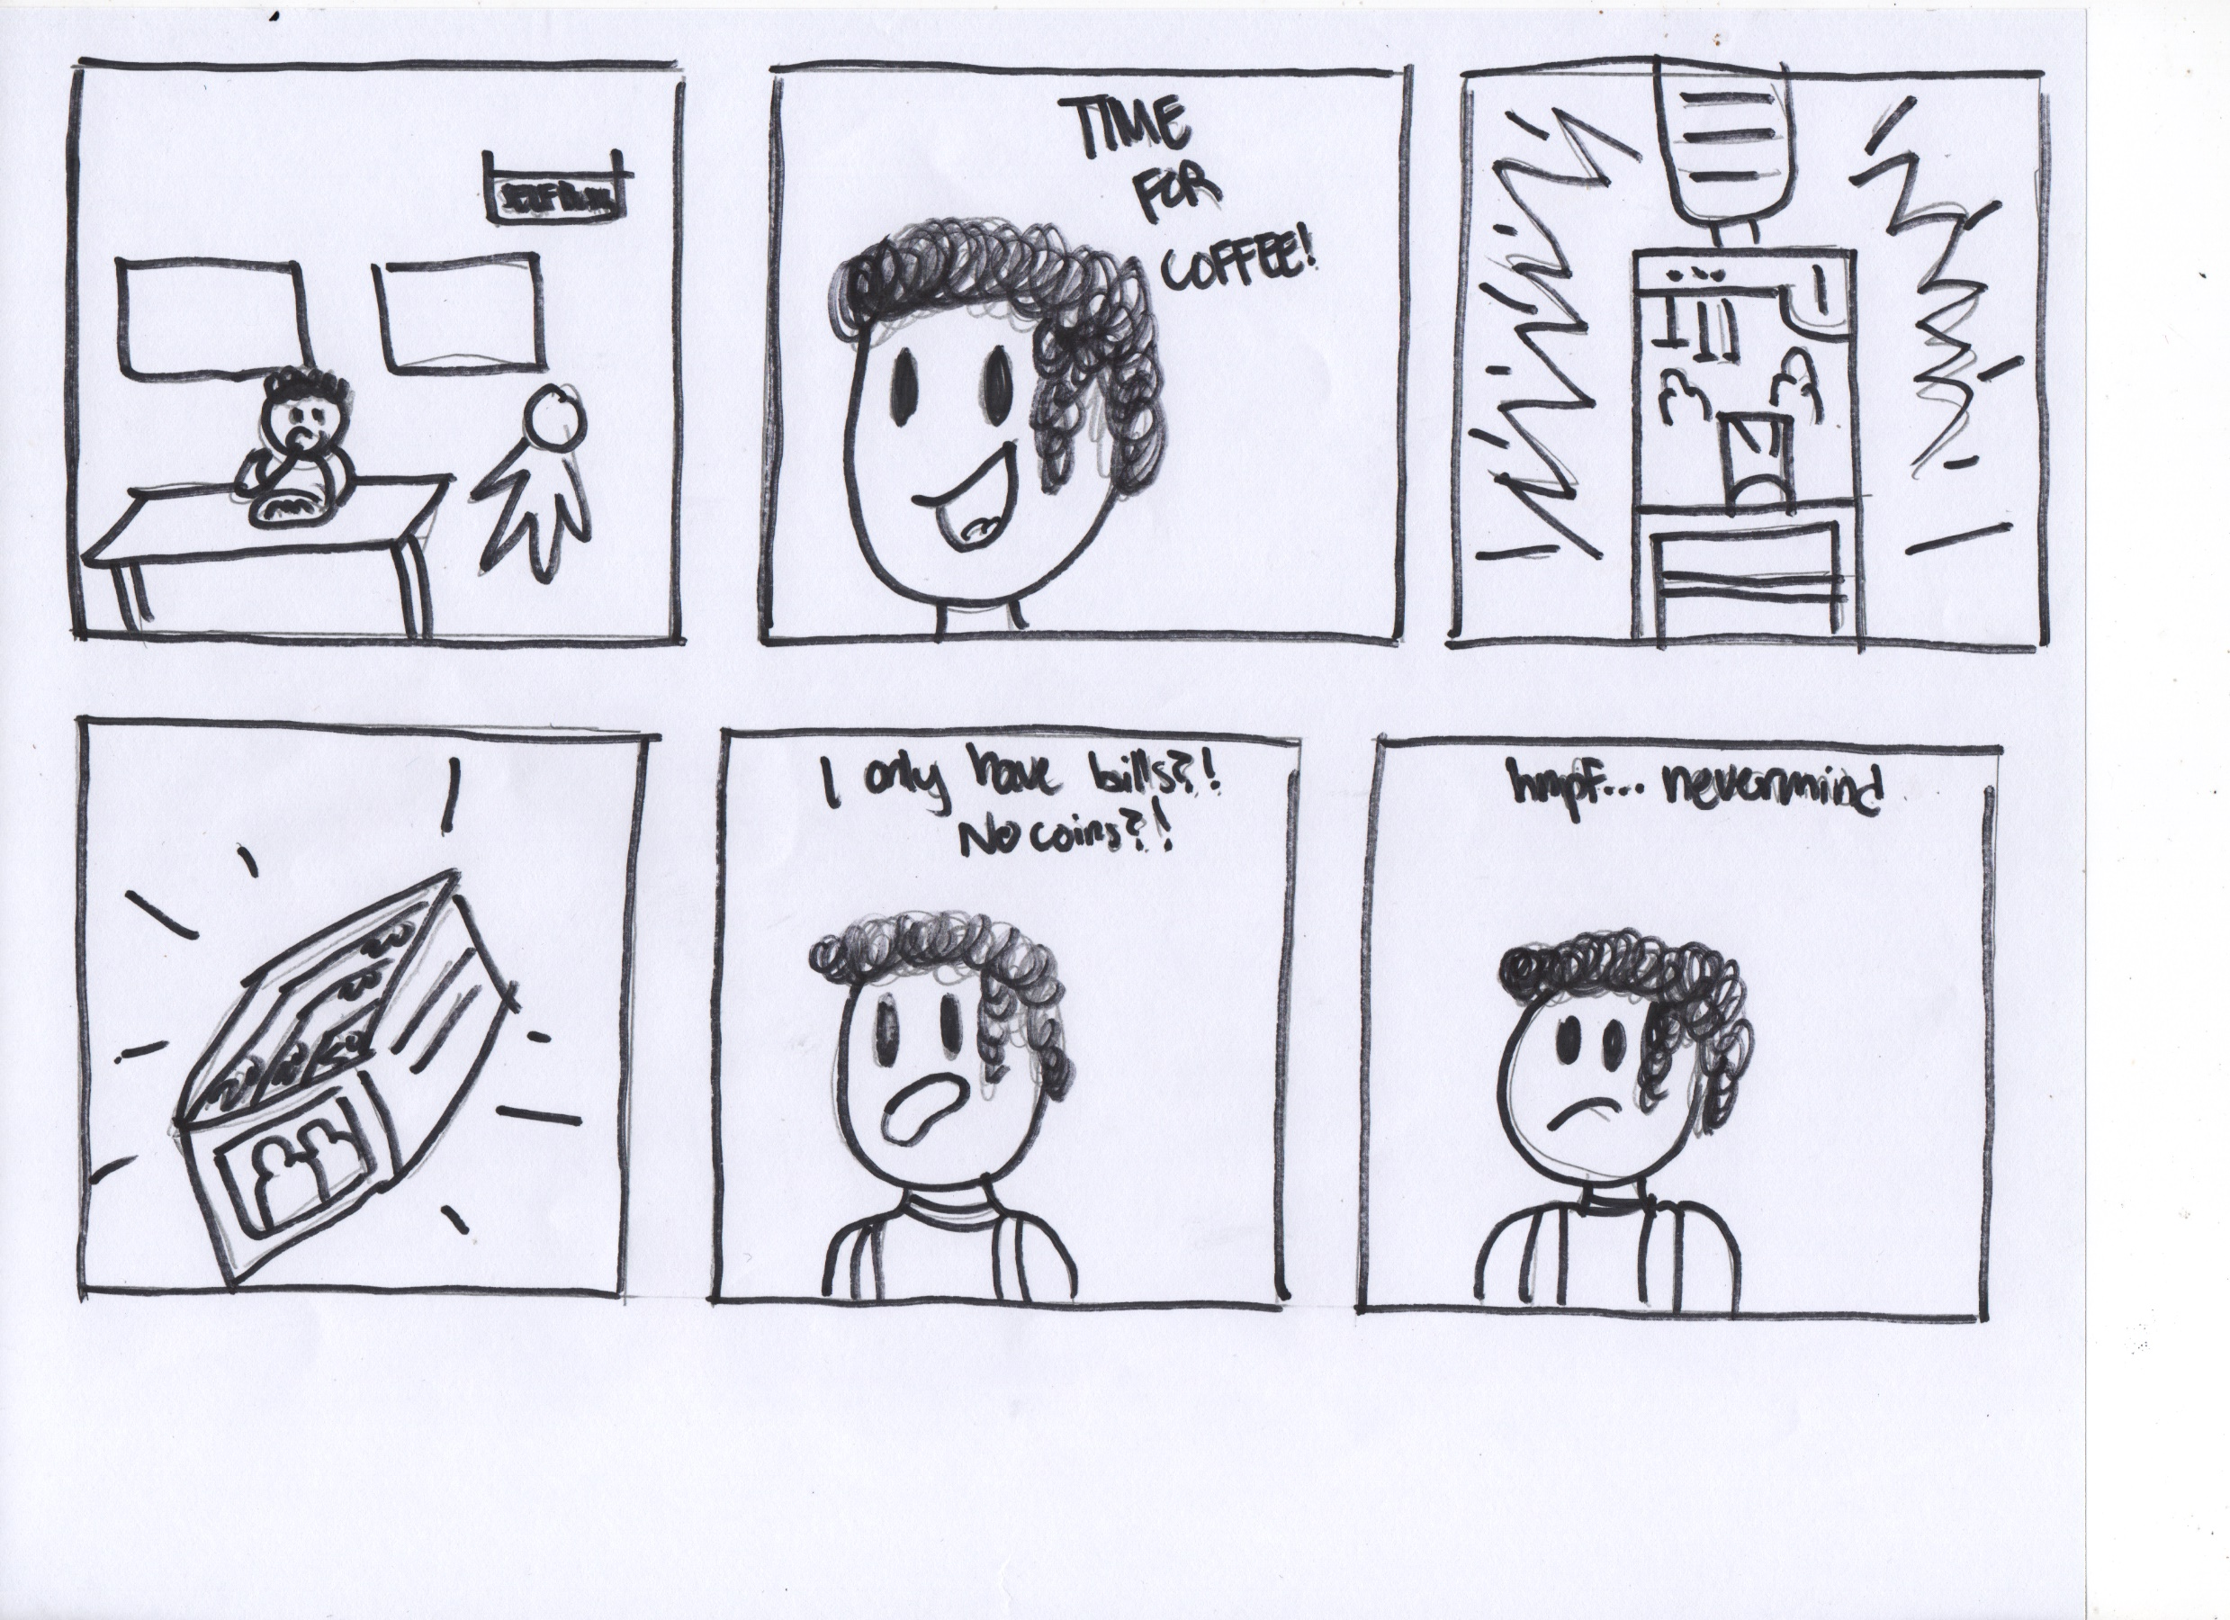

Slide 14
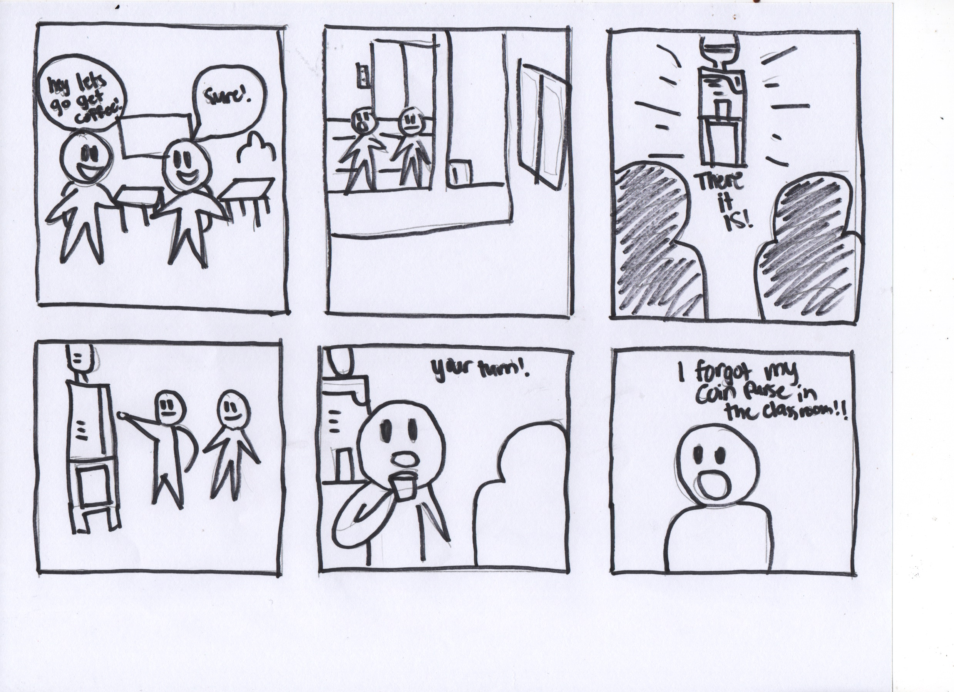

Slide 15


Slide 19
2nd Iteration

Slide 20
Changes made
Coffee Vending Machine
A coin slot was added which also allowed different coins to be put inside the machine which will then be accepted as proper payment for the drinks.

Slide 21
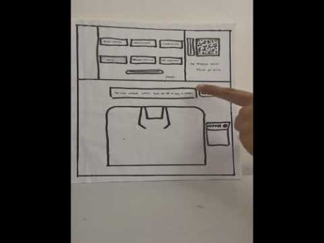

Slide 22
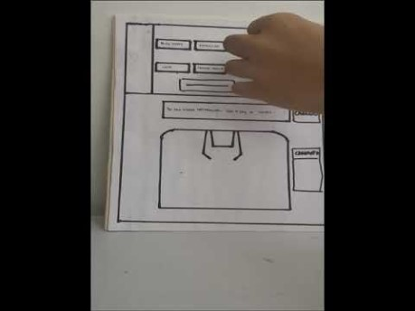

Slide 23


Slide 24
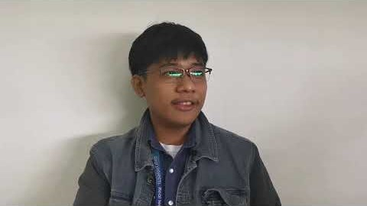

Slide 25
3rd Iteration

Slide 26
Changes made
Coffee Vending Machine
A coin slot & bill slot was added along with having a “change” section for giving proper change when buying a cup of warm drink. This also applies with using newer coins and different denominations of bills. The QR and E-Wallet is also accepted as a different payment scheme for the user.

Slide 27
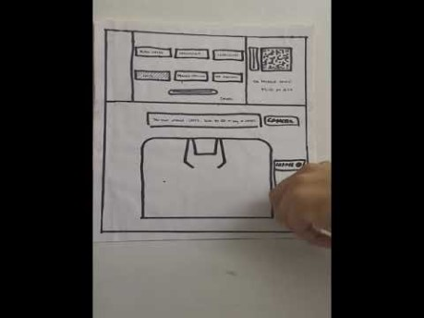

Slide 28
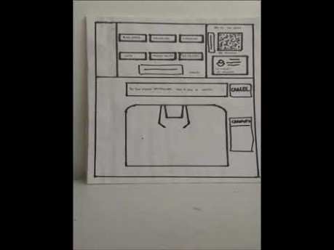

Slide 29


